Slide 1
Your Logo Here
Train the Trainer
Presenter Name | Month, Year
Notes:
RFPIO Note: We follow a Train the Trainers model, and the purpose of this slide deck is to help Admin users determine how you want to implement RFPIO to your team. This is intended as a guide to help you think about your workflow, how it will look within RPFIO, and how best to train your users. Feel free to use this deck however best suits your needs: some clients use this exact deck, some update it with their own branding, while others use this as a guide or checklist while crafting their training & implementation plan
Update Slide: Leave as is or update for custom branding
Talking Points: Throughout this deck you will see specific Talking Points here on how to position this content to your team

Slide 2
Train the Trainers Agenda
Managing Reports
Topic 2
General RFPIO Info
Project Management
Content Library & Content Mgmt.
Additional Resources
Topic 1
Notes:
RFPIO Note: This is the Agenda we will follow for today’s session. Based on your team’s needs you may choose to break up this deck and your trainings by user role or by area of the application. For example, you may train your Project Team using the Project Management Portion of this deck but may also want to include some information from other sections.
Update Slide: Update with your customized agenda topics based on your user audience
Talking Points: Briefly explain the agenda of this training and what you want your team to walk away with (for example: a fundamental understanding of how to create and respond to projects, why the Content Library is important and how that content will be managed)

Slide 3
General RFPIO
Information
Notes:
RFPIO Notes: This portion of the deck will be to provide foundational RFPIO knowledge that is relevant for all users .
Update Slide: Leave as is or update for custom look
Talking Points: This portion of the training will provide foundational knowledge for all users

Slide 4
Introduction to RFPIO
5 Pillars
Our Goals
User Roles
How to Access
My Work
General Information
Section One: Agenda
Notes:
RFPIO Notes: The most successful implementations ensure your team has a strong understanding of what RFPIO is and how it will directly help your team accomplish your goals. We encourage you to think about those goals as you are crafting your team’s training plan. Also included in this section is some foundational RFPIO information that is relevant to all users.
Update Slide: Update agenda to include your desired topics
Talking Points: Set the stage for what RFPIO is and how this new software will improve your team’s day to day life.

Slide 5
Notes:
90 second video providing a high level overview of the RFPIO solution
https://youtu.be/8fgOeP2EZ8g

Slide 6
Built on the five pillars of response management
Integrations
Respond where your team is already working via integrations with the most popular CRM, SSO, and collaboration platforms.
Collaboration
Content Management
Collaborate across teams, business units, and external partners, using in-app comments, @-mentioning.
Manage content at scale and ensure you always use the best and most relevant information with an intelligent Answer Library
Project Management
Business Intelligence
Keep your projects on track and teams aligned with a built-in suite of project management tools.
Make smarter decisions and gain insight into your process with built-in analytics and custom reports and dashboards
Notes:
RFPIO Note: The intent of this slide is to talk about the value that RFPIO will be bringing to your team. If you feel it be beneficial to your team, reviewing these pillars can show the many way implementing RFPIO will improve your company’s workflow.
Update Slide: Omit slide if desired
Talking Points: Briefly talk about the 5 pillars of RFPIO and how this solution will assist those you are training in their daily work lives.

Slide 7
Our Goals
Goal 1
Goal 2
Example: Improve efficiency when searching historical data
Example: One Central location for all projects & historical content
Goal 3
Goal 4
Example: Improve collaboration between Responders & SMEs
Example: Streamline RFP process to increase win rate
Notes:
RFPIO Note: It is ESSENTIAL to a successful implementation to cultivate team buy-in. The better your team understands what your goals are and how RFPIO will help achieve them, the smoother your transition and implementation process will go.
Update Slide: Update with your specific company goals. This is your opportunity to sell your team on how/why RFPIO is going to help make their jobs easier.
Talking Points: Take some time to discuss what your goals are, how your current workflow is changing, and what will remain the same.

Slide 8
RFPIO User Roles
 | Roles with RFPIO Login |  |  |  | Roles without
 | Super Admin | Admin with all permissions | Manager | Team members | Guest
Create Project | ✓ | ✓ | ✓ | X | X
Edit Project | ALL | ALL | MY | MY | Answer assigned questions
Content Library | ALL | ALL | MY | MY | X
Organization Setting | ✓ | ✓ | X | X | X
Each role above can be assigned as
Project Primary Contact: Receiving notifications regarding the activities that occur within the project.
Internal Contact: First point of contact for RFPIO help.
Notes:
RFPIO Note: This slide provides an overview of the different user roles within RFPIO, their various access permissions and intended responsibilities. Take this opportunity to inform your team who is going to own the Content Management and Project Management Strategies within RFPIO for your team.
Update Slide: Update this slide by removing or adding any roles your organization may be utilizing (for example, if you don’t have the Intake feature you won’t have a Project Requester Role or if you have created Custom Roles [add on feature] for your organization)
Talking Points: Talk briefly about the definition of each type of role, why they are important and how they will relate to your organization. This is also a great time to inform your team what roles you have chosen for them and why.
Relevant Help Center Information:
https://rfpio.zendesk.com/hc/en-us/articles/115003524174-User-Roles-Defined
Super Admin – Only one, full access to everything including billing & subscription information
Admin – Full access to all content & projects. Can create new user profiles and edit company settings.
Manager – Full access to the projects they create or are assigned to. Limited to only projects they are involved in and cannot see any other projects within the system.
Team Member – can author, view, add comments and clarifications to assigned sections & questions only
Guest – A user without an RFPIO login they can only answer the questions and sections to which they have been assigned. They are not able to access the content library. Anyone, even a 3rd party, can collaborate as this type of user.
Project Requester – can communicate with the proposal or bid team by submitting an intake request with the attached RFx files.
Project Primary Contact – overlay to existing role types. Allows this user to be assigned as the primary contact when creating a new project. This will enable the user to receive notifications regarding the activities that occur within the project.
Internal Contact – Your first point of contact for RFPIO Help

Slide 9
How to access
Chrome is the Preferred Browser
*If you have a login preference you can mention it here (SSO, password requirements, etc.)
app.rfpio.com
Notes:
RFPIO Note: This slide provides the opportunity for you to review your organization’s login process. Do you have SSO enabled or specific password criteria that must be met? If so, discuss what those login specifics are. As an Admin you can also set up Sign In Restrictions for your users by going to Organization Settings -> Security -> Sign In Restrictions
Update Slide: Leave as is or customize with your organization’s login page
Talking Points: Discuss how users will login to RFPIO, highlight that Chrome is the preferred browser and if you have any SSO integrations.
Relevant Help Center Information:
https://rfpio.zendesk.com/hc/en-us/articles/360005877613-How-to-Use-Sign-in-Restriction
https://rfpio.zendesk.com/hc/en-us/articles/360030935194-SSO-Setup-Classic-
https://rfpio.zendesk.com/hc/en-us/articles/360031272494-SSO-Setup-Lightning-
https://rfpio.zendesk.com/hc/en-us/articles/360042212974-Customizable-Login-Rules-with-RFPIO-Password-Policy

Slide 10
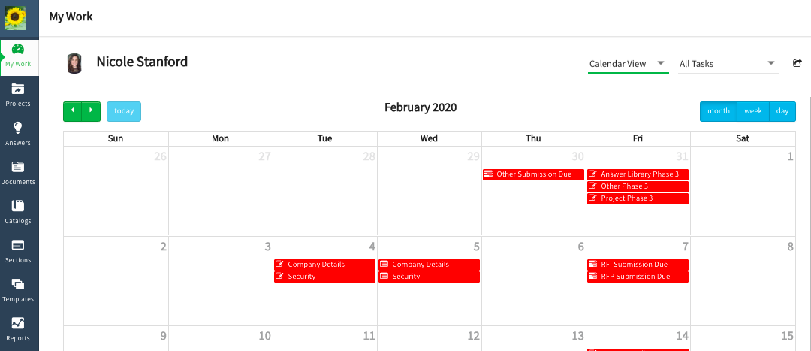
My Work
Notes:
RFPIO Note: A powerful training tool is to show a demonstration live within RFPIO. This allows your users to see features in real time and curates the training for multiple learning styles. To do this, navigate away from the slide deck and open rfpio.com in your Chrome Browser.
Update Slide: Leave as is, customize with your organization’s “My Work” page, or skip this slide entirely and show a live demonstration within RFPIO.
Talking Points: We recommend showing a live demonstration within RFPIO. Provide an overview of what your users will see, such as the left hand navigation ribbon, My Work page, various views, and how to sync user tasks to an external calendar. It can also be beneficial to take some time to highlight the user specific customization in “My Account Settings”
Relevant Help Center Information:
https://rfpio.zendesk.com/hc/en-us/articles/360005876873-How-to-Sync-Your-Calendar-with-RFPIO-Tasks

Slide 11
RFPIO Project
Management
Notes:
RFPIO Notes: This section of training needs to involve anyone who may need to work in a Project. That might be an Author, Reviewer, or Project Primary Contact. If this is your team's first time utilizing a software to work in a project, this might be a big change to your process. Make sure you take the time to check in with your team as needed.
Update Slide: Leave as is or update for custom look
Talking Points: Set the stage for how this new workflow will improve your team’s day to day life.

Slide 12
Project User Roles & Responsibilities
Project Management Team
6 Step RFP Response Process
Project Creation
Assign Authors & Reviewers
Identify Your Work
Respond with Recommendations
How to Collaborate
Review Process
Project Completion & Export
Project Reporting
Project Management
Section Two: Agenda
Notes:
RFPIO Note: Feel free to customize your training agenda as needed. We recognize that not all content presented may be applicable for your team and encourage you to modify this slide deck to suit your company’s workflow and needs.
Update Slide: Leave as is or update with custom agenda.
Talking Points: Briefly explain the agenda of this training and what you want your team to walk away with (a fundamental understanding of how to create projects, assign work, respond to questions, how to collaborate, and how to export a project)

Slide 13
Project User Roles & Responsibilities
Manager(s)
Projects
Author(s)
Reviewer(s)
Project Primary Contact
Receive notification emails regarding all the project activities
Notes:
RFPIO Note: This slide is to provide an overview of the different roles & their respective responsibilities within RFPIO
Update Slide: Add custom branding and verbiage if desired
Talking Points: Review the various roles, who will be operating in each role, and what their primary responsibility is when working on projects, as the terms you use internally might differ from the terms we use in RFPIO. Ensure your team understands how their role fits into your company’s workflow
Relevant Help Center Information:
Manager – Full access to projects they create or are added to. This role is limited to only projects they are involved with and cannot see projects they are not a team member of.
Author - only assigned to a project, the Author is responsible for answering the questions assigned to them
Reviewer - only assigned to a project, their main purpose is to review the answers provided by the Author of a question or section
Project Primary Contact - The Project primary contact is the person who owns the project , he/she gets all task updates regarding the project.
https://rfpio.zendesk.com/hc/en-us/articles/115003524174-User-Roles-Defined
https://rfpio.zendesk.com/hc/en-us/articles/360023053194-Start-Guide-Authors
https://rfpio.zendesk.com/hc/en-us/articles/360005877433-Start-Guide-Reviewers

Slide 14
List your Authors here
Project Management Team
List your Reviewers here
List your Project Primary Contacts here
Notes:
RFPIO Note: This optional slide is intended to help you outline for your team who is going to be responsible for authoring and/or reviewing project content. The importance of this slide is so your team will know who will be owning what part of the project process and who they should contact if they questions regarding a specific project (Project Primary Contact).
Update Slide: Add the individual’s name for each role if desired
Talking Points: Reiterate what the primary focus of these individuals will be and how they fit into your company’s workflow

Slide 15
6-step RFP response process
Be more productive (and less reactive) with this 6-step RFP response process that helps you build a collaborative workflow with your response management team.
Notes:
RFPIO Note: This graphic shows what a common RFP workflow looks like and can help you illustrate for your team how your workflow is changing and what will remain the same. This will help cultivate team buy-in and set them up for success.
Update Slide: Leave as is or update with your custom RFP Workflow
Talking Points: If using this graphic, briefly explain how your workflow fits into this 6 step process, how it is different from what you’ve done before, and what is going to stay the same. If you don’t use this graphic it’s still good to review your workflow as a whole: how it is changing? how it will stay the same?

Slide 16
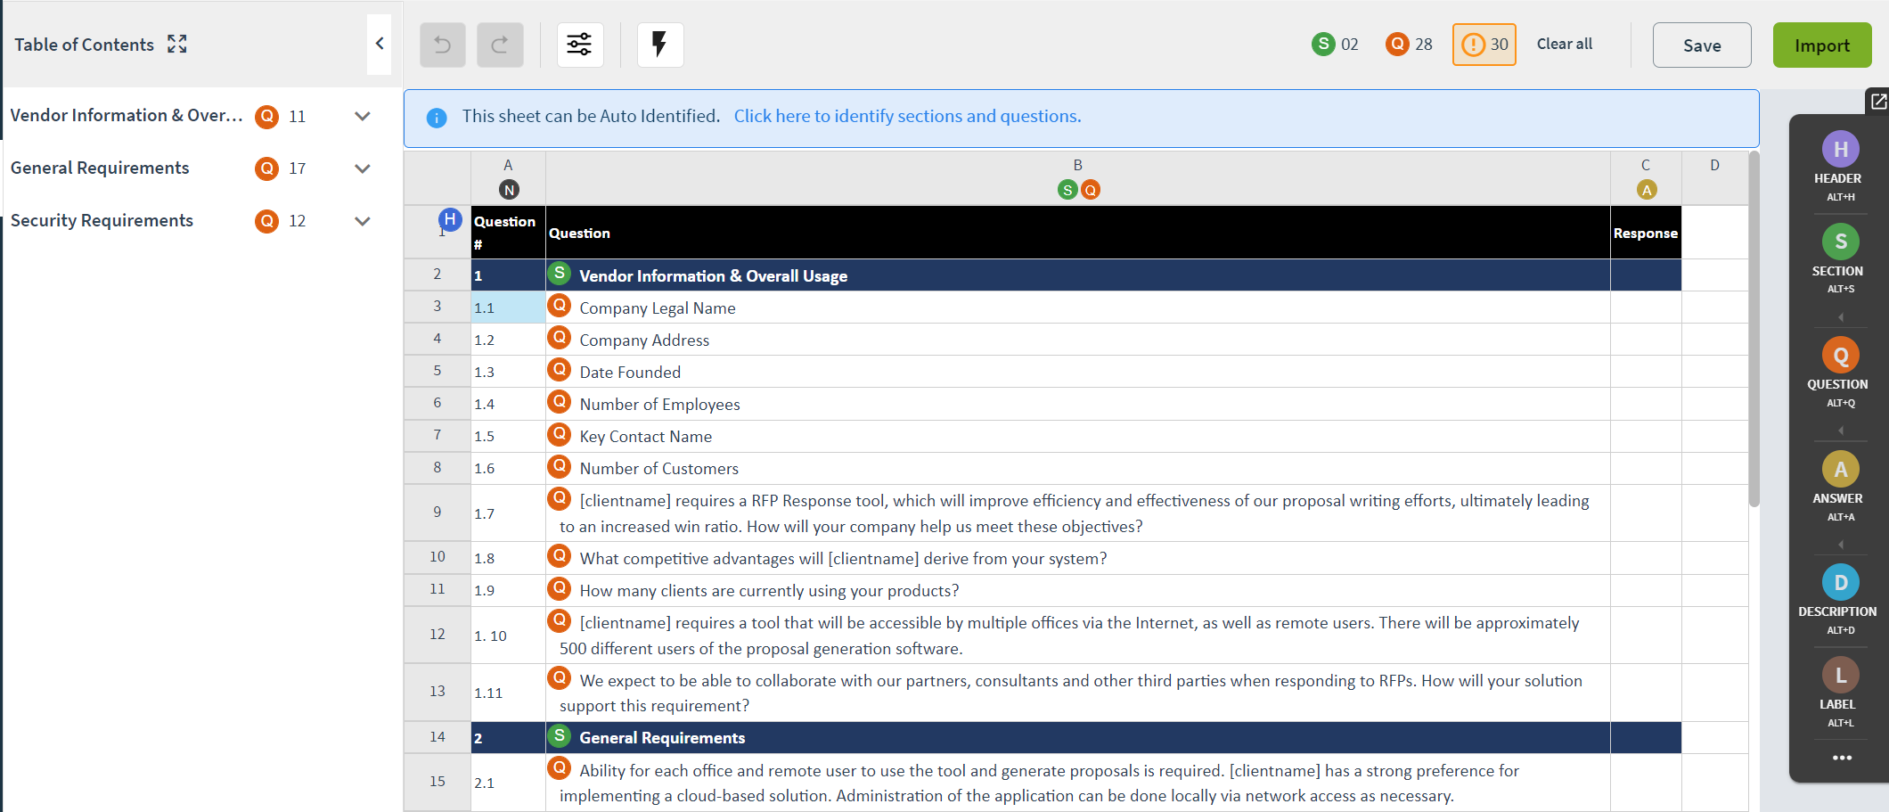
Project Creation
Mapping Documents
Importing Documents
Notes:
RFPIO Note: On this slide you should cover the ins and outs of importing a common RFP document. Note that only users who will be creating projects and mapping documents need to be included in this portion of the training. It can be beneficial for your Project Creators (Admins or Managers) to review the importing fundamentals link below prior to this training
How to set up the slide: Leave as is or update for custom look and feel with a familiar project.
Talking Points: We recommend navigating to RFPIO and showing a live demonstration on how to map a common RFP document or even a current project. Talk about identifying sections, questions, (and in the case of at table/Excel file, where answer should go) in the file upon document mapping.
Relevant Help Center Information:
https://rfpio.zendesk.com/hc/en-us/articles/115001824713-Importing-Fundamentals

Slide 17
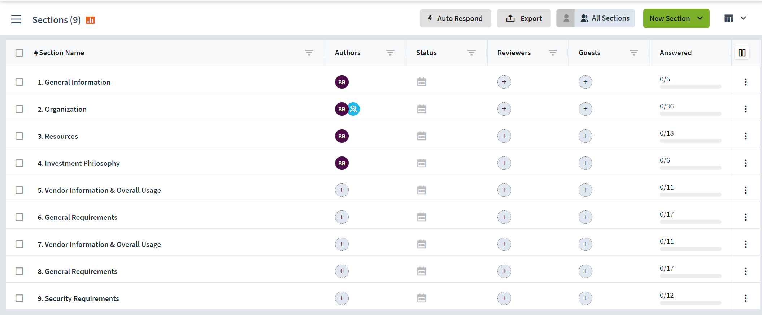
Assign Authors & Reviewers
Authors – Section & Question Level
Reviewers – Section Level
Assigning Due Dates
Notes:
RFPIO Note: This slide may be one of the most important messages to convey to your Project Creators. The ability to assign sections, questions and due dates are key steps to designing your workflows. These steps allow you to divide and conquer your projects. *Note that Team Members can add Authors but can’t remove Authors.
Update Slide: Leave as is or update for custom look and feel with a familiar project.
Talking Points: Briefly provide an overview on Author & Reviewer roles and why they are important. Also discuss your team’s workflow. Will your Project Creators take a first pass at answering questions themselves? Or will they immediately assign Authors to respond? Do you have an established Review process? If so, what does that look like? Then demonstrate how to assign Authors and Reviewers at a section level and a question level. We recommend navigating into RFPIO to show a live demonstration on how to make assignments.
Relevant Help Center Information:
https://rfpio.zendesk.com/hc/en-us/articles/360023053194-Start-Guide-Authors
https://rfpio.zendesk.com/hc/en-us/articles/360005877433-Start-Guide-Reviewers
https://rfpio.zendesk.com/hc/en-us/articles/360005788874-How-to-Assign-Authors-to-a-Section
https://rfpio.zendesk.com/hc/en-us/articles/360005872273-How-to-assign-a-question-to-a-guest
https://rfpio.zendesk.com/hc/en-us/articles/360005868073-How-to-Assign-the-Project-Primary-Contact
How to set up the slide: Leave as is or update for custom look and feel with a familiar project.
Talking Points: We recommend navigating to RFPIO and showing a live demonstration on how to map a common RFP document or even a current project. Talk about identifying sections, questions, (and in the case of at table/Excel file, where answer should go) in the file upon document mapping.
Relevant Help Center Information:
https://rfpio.zendesk.com/hc/en-us/articles/115001824713-Importing-Fundamentals

Slide 18
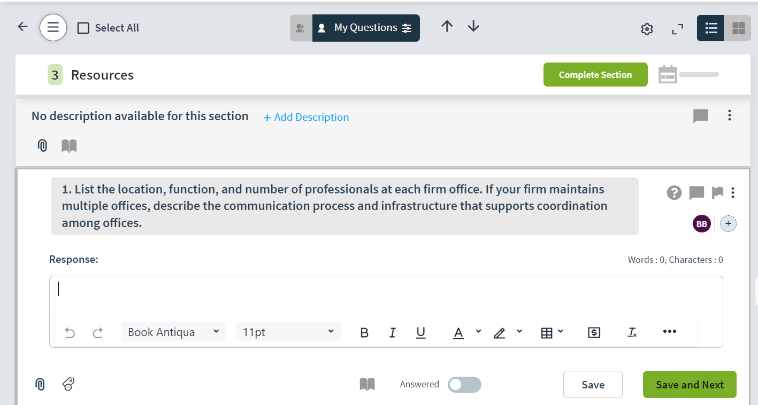
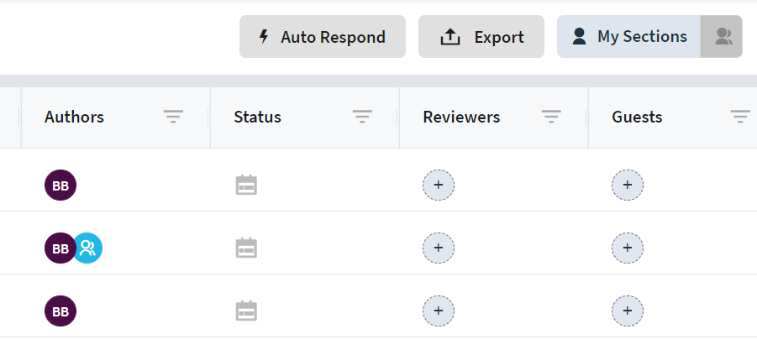
Section Level
Project Level
Notes:
RFPIO Note: Once your team understands how to assign work next they need to know how to find their assignments. This portion of the training should include any team members who will be working on projects.
Update Slide: Leave as is or update for custom look and feel with a familiar project.
Talking Points: We suggest continuing the Live Demo in RFPIO. Show your team how they can see their assignments from the "My Work" page or how they can filter their assigned questions from both the Project and Section Level. Also take a moment to show your team how to manually respond to questions (without the Recommendation Engine).
Relevant Help Center Information:
https://rfpio.zendesk.com/hc/en-us/articles/360005876793-How-to-Filter-Questions-by-a-Specific-Author
https://rfpio.zendesk.com/hc/en-us/articles/360005864993-How-to-See-Which-Questions-Are-Assigned-to-an-author-in-a-Project
https://rfpio.zendesk.com/hc/en-us/articles/360023053194-Start-Guide-Authors

Slide 19
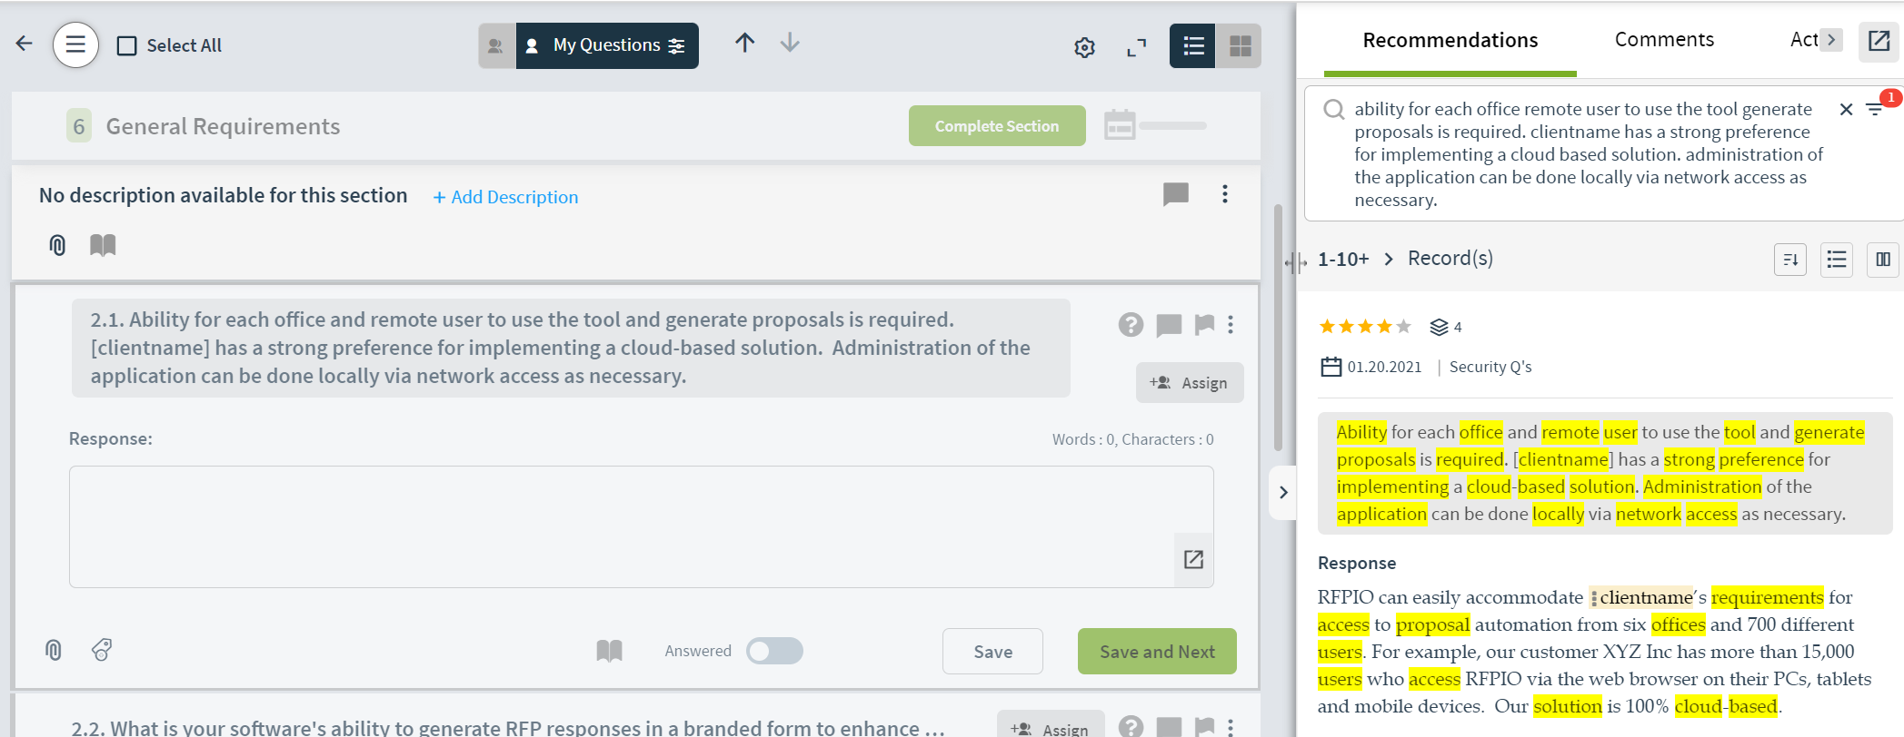
Respond with Recommendations
Default Recommendations
Recommendation View
Advanced Filter
Understanding the Metadata
Notes:
RFPIO Note: The Recommendation Engine is one of the paramount and most valuable features available to your team within a project. It’s helpful for your team to understand where these recommendations come from (the Answer Library) and how they are suggested (Keyword Match, Star Rating, Used Count, & Last Updated Date).
Update Slide: Leave as is or update for custom look and feel with a familiar project.
Talking Points: Take some time to discuss how the system recommends answers based on the Keyword Match, Star Rating, Used Count, & Last Updated Date. Show your team how to apply an answer from the Recommendation Engine and highlight the Advanced Filter Search. Ensuring your team is comfortable with the Recommendation Engine and Advanced Filter Search will help set them up for success. This is also a good time to talk about the “Save in Answer Library” toggle and that the “Complete Section” button is what triggers that content to be sent to the Answer Library
Relevant Help Center Information: https://rfpio.zendesk.com/hc/en-us/articles/115002315094-How-to-Apply-Answers-from-the-Recommendation-Engine-
https://rfpio.zendesk.com/hc/en-us/articles/360005872193-How-to-Use-the-Advanced-Search-Settings-in-the-Recommendation-Engine
https://rfpio.zendesk.com/hc/en-us/articles/360005794294-How-to-Use-Advance-Search-Filters-in-the-Answer-Library-Recommendation-Engine

Slide 20
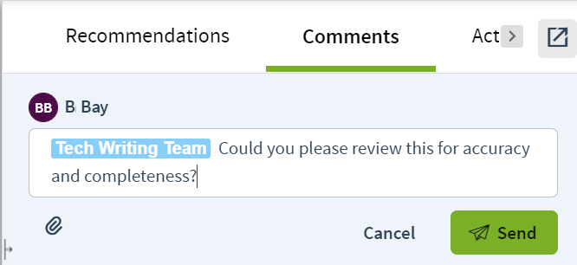
How to Collaborate
Comments
Clarifications
Chat
Flag
Resolve
Slack Integration
Notes:
RFPIO Note: As your team is working on a project they may have a need to collaborate with others to complete their work. RFPIO has many built-in collaboration features such as Comments & In Application Chat.
Update Slide: Leave as is or update with custom screenshot. Remove any bullet points of features that your team will not be using.
Talking Points: Spend some time talking about how to create, respond to, & resolve a comment; also discuss the difference between a comment & a clarification. If you have Slack , Hangouts, or Teams Integration you can mention it here.
Relevant Help Center Information: Clarifications: Clarifications are mainly used for external communication to where you can post clarifying questions that are attached to the content in question and can be exported and sent to the issuer. https://rfpio.zendesk.com/hc/en-us/articles/360005788734-How-to-Use-Comments-to-Collaborate
https://rfpio.zendesk.com/hc/en-us/articles/360005864973-How-to-Use-Comments-to-Discuss-Questions
https://rfpio.zendesk.com/hc/en-us/articles/360005864833-How-to-Leave-Comments-and-See-All-Comments-in-a-Project
https://rfpio.zendesk.com/hc/en-us/articles/360005871993-How-to-Mark-a-Comment-as-Resolved
https://rfpio.zendesk.com/hc/en-us/articles/360005863373-How-to-Use-Clarifications-in-a-Project
https://rfpio.zendesk.com/hc/en-us/articles/360030377373-Slack-Integration-
https://rfpio.zendesk.com/hc/en-us/articles/360039495873-Creating-and-Managing-Flags

Slide 21
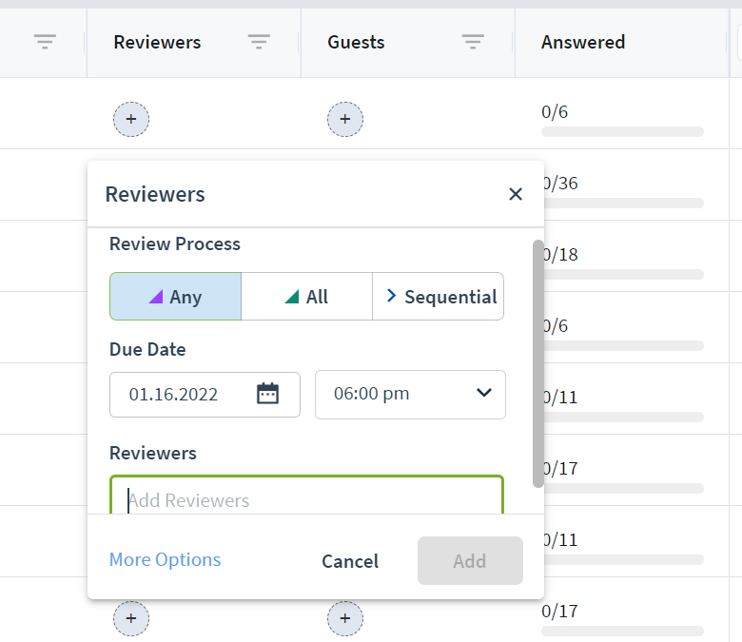
Review Process
What to Review
Making Corrections
Requesting Corrections
Mark as Reviewed
Complete Section
Notes:
RFPIO Note: After questions have been responded to, your company may have a review process in place. If your company has a Review workflow, discuss what that process is and who your Reviewers will be.
Update Slide: Leave as is or update with your company’s Review Process
Talking Points: The main things to touch on are to tell your team what a reviewer is, what your company’s review workflow looks like, and how to make the corrections, if needed. It is also important to note that if a Review has been enabled the content from a project won’t be sent to the Answer Library (f the “Save in Answer Library” toggle is turned on) until after the Review has been completed.
Relevant Help Center Information: https://rfpio.zendesk.com/hc/en-us/articles/360005877433-Start-Guide-Reviewers https://rfpio.zendesk.com/hc/en-us/articles/360005778954-How-to-Assign-Sequential-Reviewers

Slide 22
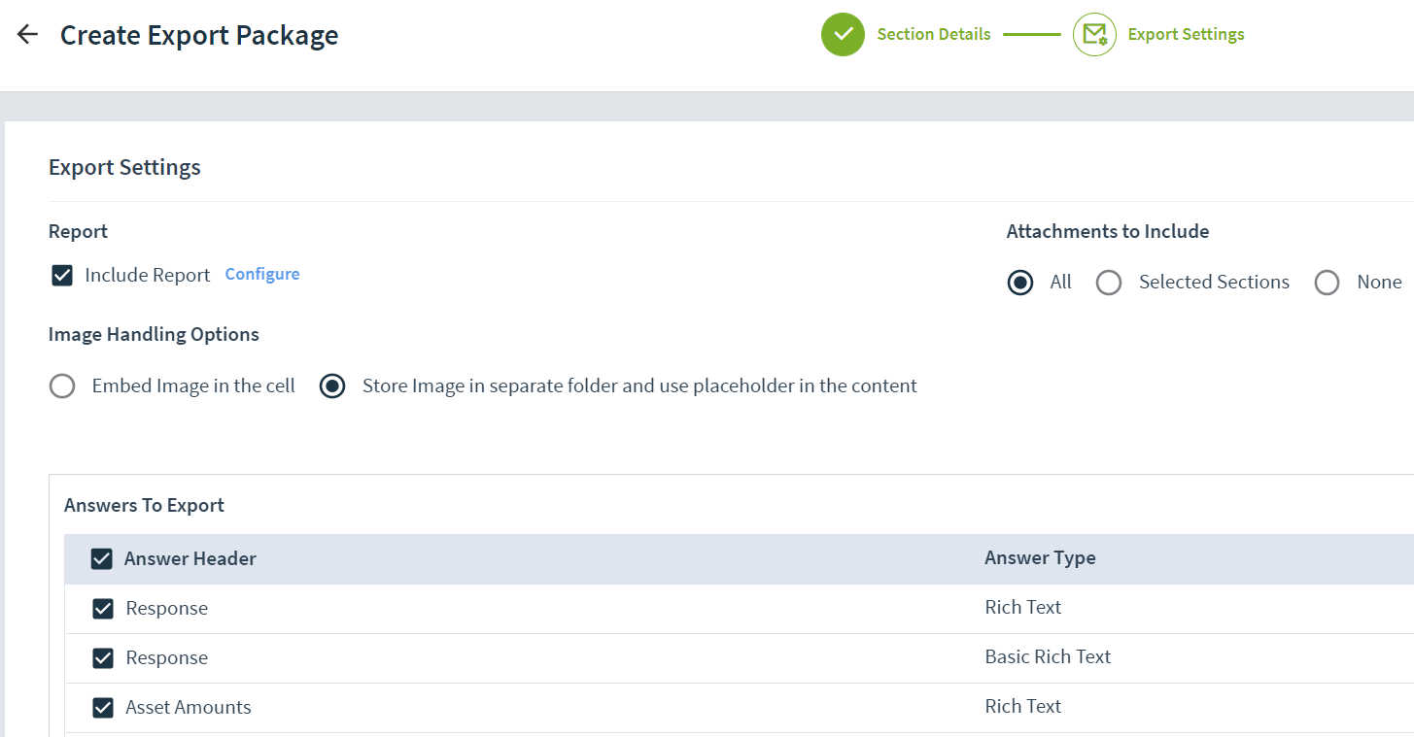
Project Completion & Export
Update Stage
Tasks & Discussions
Mark Sections as Complete
Export Responses
Notes:
RFPIO Note: It’s important to clearly define for your team who will be responsible for exporting the project and sending the final version back to the issuer. Review your project completion workflow in its entirety, including items that fall outside of RFPIO. It can be helpful to show your team a live demonstration of your project completion workflow.
Update Slide: Leave as is or update for custom look and feel with a familiar project.
Talking Points: Review your company’s project completion workflow. Discuss the steps your team needs to take both in and out of RFPIO to prepare the final project to return to the Requestor. Will you be exporting projects back into the source document or do you have a Response Template you want your team to use? Specifically, you should highlight how to update the Project Stage, Marking Sections & the overall Project as complete, and if needed, resolving comments. It can be helpful to show your team a live demonstration in RFPIO on how to complete and export a project. Specifically you should highlight how to update the Project Stage, Marking Sections and the overall Project as Complete, if you’ll be exporting back into the source document or into a Response Template, and resolving comments, if needed.
Relevant Help Center Information:
https://rfpio.zendesk.com/hc/en-us/articles/360005871473-How-to-Export-an-Active-Project

Slide 23
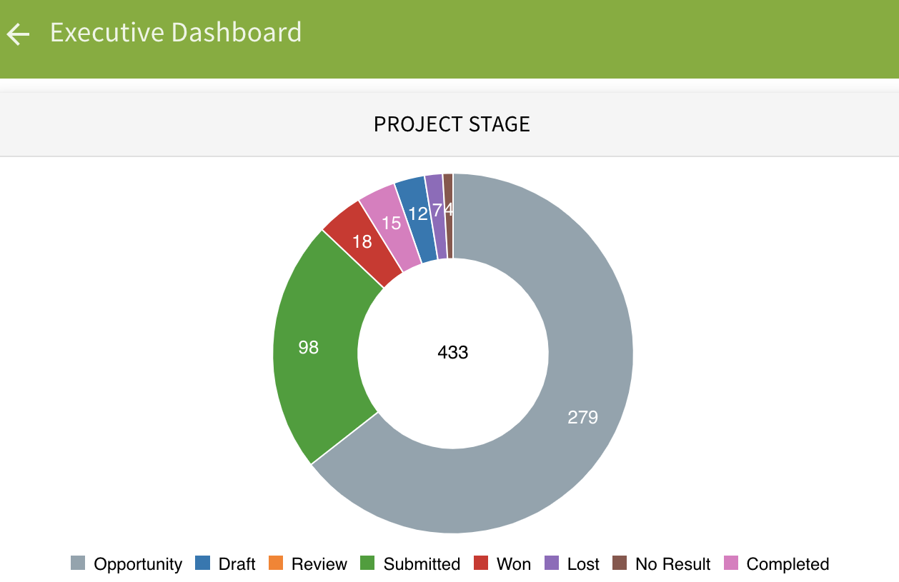
Project Reporting
Project Overview
Executive Dashboard
Task Report
Notes:
RFPIO Note: The reporting feature is available to Admins and Managers who are looking to gather data spanning all and/or their own projects. It is our data gold mine! Executive Dashboard - *DOES INCLUDE ARCHIVED PROJECTS*
Update Slide: Leave as is or update for custom look and feel with a familiar report.
Talking Points: Discuss the types of Reports your team will be using to help keep Projects on track. Specifically show the Executive Dashboard and it how it provides a high-level overview of the project types, win/loss assessment, and project values. It can be beneficial to show a live demonstration of the Report features by navigating into your RPFIO Instance.
Relevant Help Center Information: https://rfpio.zendesk.com/hc/en-us/articles/360033981273-Reporting-in-RFPIO https://rfpio.zendesk.com/hc/en-us/articles/360004902774-RFPIO-Webinar-Reporting-in-RFPIO-What-to-Measure-for-Success-May-2018

Slide 24
Content Library
Notes:
RFPIO Notes: This portion of the training is intended for any users who will be managing Content and/or your Answer Library. Include any members of your team that will be assisting with Content Management.
Update Slide: Leave as is or update for custom look and feel
Talking Points: The Answer Library is the foundation of the response process. It’s important for your team to keep your Answer Library content clean, up to date, and ready to be used.

Slide 25
Answer Library Agenda
What, Why, & How?
Content Management Team
Content Owners & Review Cycles
Organization Strategy
Moderation
Reporting
Notes:
RFPIO Note: Feel free to customize your training agenda as needed. We recognize that not all content presented may be applicable for your team and encourage you to modify this slide deck to suit your company’s workflow and needs.
Update Slide: Leave as is or update with custom agenda items
Talking Points: Review the goals of what knowledge you want your team to walk away with: such as The Importance of the Answer Library, How Content is Imported into the Answer Library, Who your Content Owners Are, and What your Review Cycle workflow will be.

Slide 26
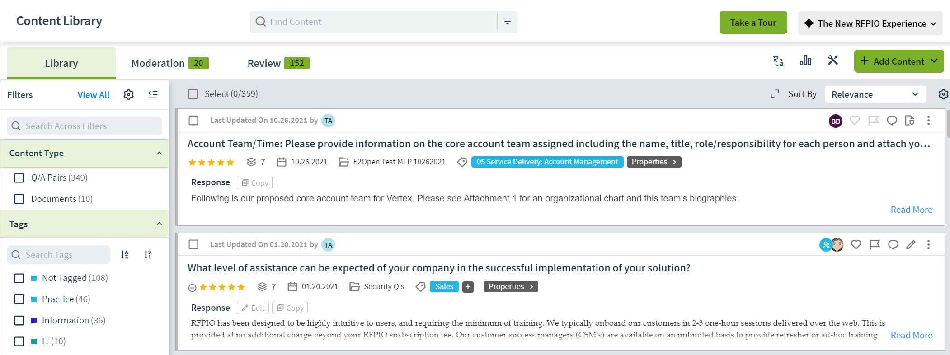
What, Why, and How?
Notes:
RFPIO Note: This slide provides an opportunity to reiterate the importance of the Content Library, how it relates to the Recommendation Engine, and how a well managed and organized Content Library makes for stronger recommendations. Discuss how leveraging the Content Library will benefit your team and help make responding to questions easier.
Update Slide: Leave as is or update for custom look and feel with familiar content (you can show an example of the type of content you want/have in your Answer Library)
Talking Points: Talk about the type of content you have there and/or will be importing there and why. Is there any specific criteria you’d like to set regarding what information should be imported into the Answer Library? If so, discuss this. You can also take a moment to explain the 3 ways content is sent to the Answer Library (either by Individual Q&A Pair, uploading a completed document, or by completing a Section/Project)

Slide 27
List your Content Owners here
Content Management Team
List your Moderators here
List your Admins here
Notes:
RFPIO Note: It’s important for your team to know who owns your company’s Content Management Strategy and will be responsible for maintaining the accuracy of your content.
Update Slide: Add the individual’s name for each role. Depending on the size of your team you may not need this slide.
Talking Points: Reiterate what the primary responsibilities of these individuals will be
Relevant Help Center Information: https://rfpio.zendesk.com/hc/en-us/articles/360005777114-Start-Guide-Content-Owner-Answer-Library
https://rfpio.zendesk.com/hc/en-us/articles/115002437833-RFPIO-Webinar-Content-Management-Best-Practices-September-2017
Moderator (if enabled) - provides a function that is only applicable to the Answer Library, the Moderator will review any edits made to an existing Q&A pair or to approve new content to be sent to the Answer Library
Owner - only assigned to content within the Answer Library. The owner is responsible for maintaining the accuracy of Answer Library content.

Slide 28
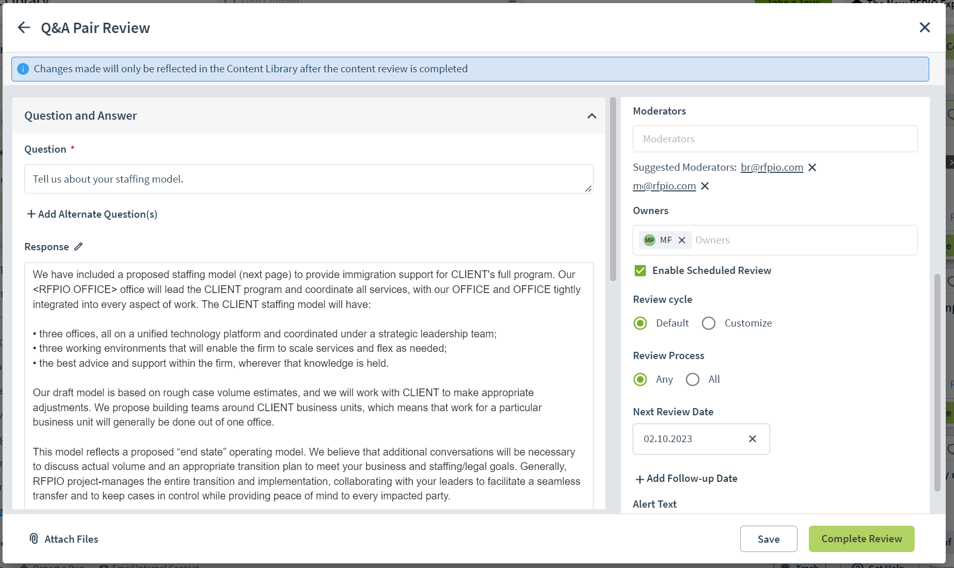
Owners & Review Cycles
Your Content Owners here
Reviews will be conducted every “X” months
Notes:
RFPIO Note: A few questions to think about prior to training your team are: How often will your content be reviewed? How will that cycle differ based on the type of content? Who are you Content Owners? Will you conduct one training session or break it up by Subject Matter Expert Group? Talk to your Content Owners about how they will own & review their content within RFPIO.
Update Slide: Update with your Content Owners. Can leave existing screenshot or update with customized content
Talking Points: We suggest navigating into RFPIO to show a live demo on how to complete a Review Cycle within RFPIO. If your content owners will only be using RFPIO on a cyclical basis to review their content, it can be helpful for them to bookmark the below resources. We also have clients who host a regular “Virtual Pizza Party” for all of their content owners to review and approve content together. We encourage you to find what works best for your team.
Relevant Help Center Information: https://rfpio.zendesk.com/hc/en-us/articles/360005861753-Assigning-Owners-and-Review-Cycles-in-the-Answer-Library
https://rfpio.zendesk.com/hc/en-us/articles/360005862033-How-to-Complete-a-Review-Cycle-in-the-Answer-Library
https://rfpio.zendesk.com/hc/en-us/articles/360005777114-Start-Guide-Content-Owner-Answer-Library

Slide 29
Organization Strategy
Tags
Custom Fields
Advanced Search Filter
Collections
Notes:
RFPIO Note: It’s important for your team to understand your company’s Answer Library Organization Strategy and how you came to that decision.
Update Slide: Leave as is or update for custom look and feel with a familiar project.
Talking Points: Talk about your company’s Organization Strategy and highlight any specific tags, custom fields, or collections that you are using. We recommend demonstrating live within RFPIO how to leverage your organization structure in the Advanced Search Filter.
Relevant Help Center Information:
https://rfpio.zendesk.com/hc/en-us/articles/360046308394-RFPIO-Webinar-Building-and-Maintaining-Your-RFPIO-Content-April-2020
https://rfpio.zendesk.com/hc/en-us/articles/115002437833-RFPIO-Webinar-Content-Management-Best-Practices-September-2017 https://rfpio.zendesk.com/hc/en-us/articles/360043695653-How-to-Create-Tags
https://rfpio.zendesk.com/hc/en-us/articles/360005864873-How-to-Assign-and-Bulk-Assign-Tags-to-Questions
Custom Fields- Users can map content to the Custom Fields and filter the content based on the custom field. It simplifies categorizing content within the Answer Library.
https://rfpio.zendesk.com/hc/en-us/articles/360020249793-Creating-Custom-Fields-in-Answer-Library-
https://rfpio.zendesk.com/hc/en-us/articles/360007390434-How-to-add-custom-fields-to-project
Collections- A Collection is a group of data (frequently identified by a tag) within your Answer Library, often with restricted access and edit rights. Collections provide a way for walls to be created within your Answer Library.
https://rfpio.zendesk.com/hc/en-us/articles/360037184153-Use-Collections-to-Create-Internal-Knowledge-Base

Slide 30
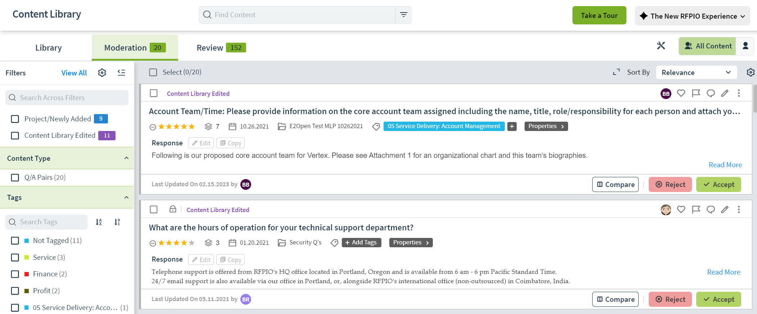
Content Library Moderation
List of who will be responsible for moderating content
Describe your moderation workflow
Notes:
RFPIO Note: If Moderation is enabled for your Company your users should understand what Moderation is and how content flows through Moderation.
Update Slide: Leave as is or update with a custom screenshot or skip this slide if you do not have Moderation enabled.
Talking Points: Talk about who has access to moderation, who will be responsible for moderating content, and define the use case for when you might need a Moderator assigned to a Q&A pair. Additionally, if you have chosen to enable the “Edit in Answer Library” Moderation Preference discuss if you will have chosen to keep a copy of the original response in the Answer Library while it’s in Moderation or if it will be removed entirely from the Answer Library until it’s released from Moderation. .
Relevant Help Center Information:
https://rfpio.zendesk.com/hc/en-us/articles/360016102853-How-to-set-Moderators-for-the-Answer-Library-content
https://rfpio.zendesk.com/hc/en-us/articles/360005861633-How-to-Set-Up-Answer-Library-Moderation-Workflow

Slide 31
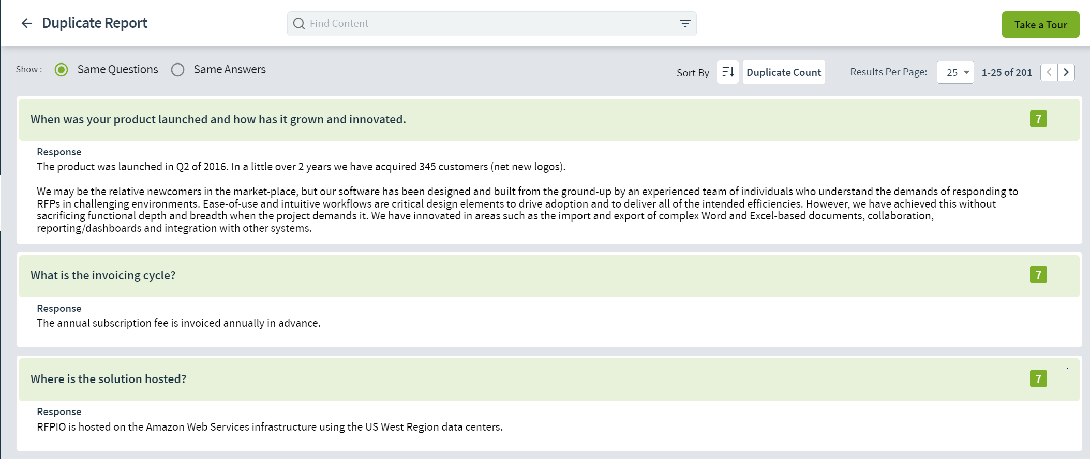
Duplicate Report
Our Duplicate Report will be run (every X days/months) by [insert name here]
Notes:
RFPIO Note: Another way to ensure content is maintained well is by utilizing the Duplicate Report. This report will identify similar content in the Content Library and provide the ability to delete or compare & merge similar content. This report can be run based on the filters you have applied for the desired content. If you feel it would be beneficial for your team, we recommend navigating to your RPFIO Instance and showing a live demonstration of this report.
Update Slide: Update with the name of the person who will be owning the Duplicate Report cycle.
Talking Points: Talk to your team about what the Duplicate Report is, what it does, who will be responsible for running it, and how often it will be run.
Relevant Help Center Information:
https://rfpio.zendesk.com/hc/en-us/articles/360005777354--How-to-Clean-up-Duplicates-in-the-Answer-Library

Slide 32
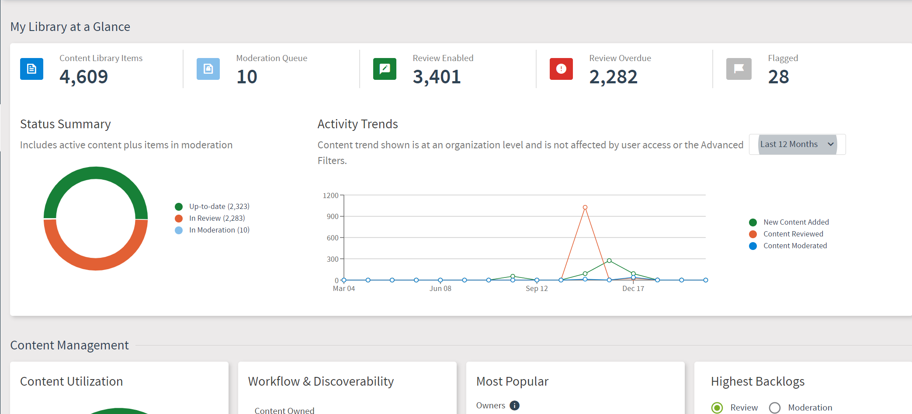
Insights Report
Notes:
RFPIO Note: One of the most powerful tools in maintaining your Content is the Insights Report. This provides a high level and dynamic view of the health of your Content Library and can be run based on any currently applied filters. Note that some users with the Manager Role won’t have access to this report, however it is still valuable for them to know this report exists and how it can be used.
Update Slide: Leave as is or update with a custom screenshot of your Insights Report
Talking Points: It can be helpful to show your team a live demonstration of the Insights Report by navigating to RFPIO. Discuss the different types of data you can find there and how to click into the report and action off the information found there.
Relevant Help Center Information:
https://rfpio.zendesk.com/hc/en-us/articles/360033981273-Reporting-in-RFPIO
https://rfpio.zendesk.com/hc/en-us/articles/360004902774-RFPIO-Webinar-Reporting-in-RFPIO-What-to-Measure-for-Success-May-2018
Types of reports are:
Total Questions
Review Overdue
Review Enabled
Flagged
Owners
Content Usage
Top Owners
Moderators
Top Moderators
Star Rating
Attachments
Standard Response
Timeline
Top Projects
Top Collections
Tags
Custom Fields

Slide 33
Additional
Resources
Notes:
RFPIO Notes: We suggest highlighting the many resources available to help users of all levels gain a better understanding of RFPIO, such as the Help Center, Submit Ideas button, and Support team
Update Slide: Leave as is or update for a custom look/feel
Talking Points: Share that RFPIO has many resources available to help answer questions your team may have.
Relevant Help Center Information:
https://rfpio.zendesk.com/hc/en-us

Slide 34
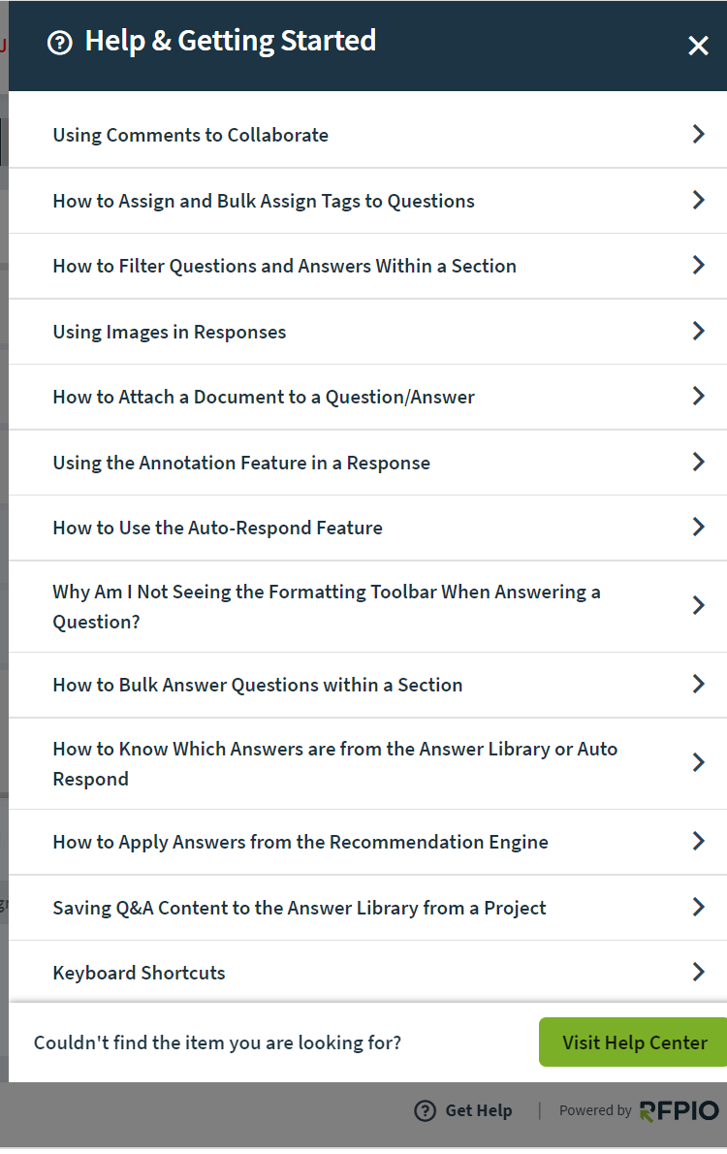
Need Extra Help?
RFPIO has a Help Center full of step-by-step guides and video tutorials to get you to RFPIO Guru Status.
Notes:
RFPIO Note: Our Help Center has a wide array of content to assist users in their roles. Show your team where to find the “Need Help” button, the “Submit Ideas” button, and – if you’ve defined one – who your company’s Internal Contact is.
Update Slide: Leave slide as is or update for a custom look/feel
Talking Points: Show your team the “Need Help” button and Help Center. Note that the content shown in the “Need Help” panel will be relevant to whatever they are currently doing within the tool. If you have designated an Internal Contact for your company, also highlight the “Email Internal Contact” button and who that will be. The Internal Contact is your company’s RFPIO user who is your team’s first point of contact for RFPIO questions. You can also show your team the “Submit Ideas” button and how RFPIO integrates user feedback directly into new feature releases.
Relevant Help Center Information:
https://rfpio.zendesk.com/hc/en-us/articles/360005795714-How-to-Setup-and-Use-Internal-Contact

Slide 35
RFPIO Support
RFPIO has a wonderful support team that provides 24/5 support to all RFPIO users
Notes:
RFPIO Note: If your team has checked the Help Center but still requires assistance, they can submit a Support Ticket to work with our Customer Support team, they are available 24 hours a day, 5 days a week.
Update Slide: Leave slide as is or update for a custom look/feel
Talking Points: Show your team how easy it is to submit a support ticket. We offer 24/5 support coverage for all our users.

Slide 36
Questions?
Notes:
We encourage you to build in enough time during each training session to allow time for questions. Generally, we have found that most users’ questions aren’t specifically on how to use the application but rather focus on your won internal workflow.
Keep in mind you may need to train your team more than once.
Things to consider:
How often will you be hosting a refresher course?
How will you train new hires to your team?
How will you update & train your team on new RFPIO features?
Our Customer Success Team is here to help provide guidance on this slide deck and how to set your team up for success. However, please note that ultimately how to train your team and present them with this information will be unique to you and your company’s needs.

